Slide 1
IST 3420: Introduction to Data Science and Management
Part 2: R Programming

Slide 2
Agenda
Introduction to R Programming
Data Structures in R
R Functions
Control Structures in R
R Programming Style and Debug
Dynamic Report: R Markdown

Slide 3
Introduction to R Programming

Slide 4

R
A free, open-source programming language for statistical computing
An interpreted language (executed directly, no compilation)
R supports matrix arithmetic (like Matlab)
R supports both procedural programming and object-oriented programming

Slide 5
Comprehensive R Archive Network
Capability extended through a packaging system on CRAN, the Comprehensive R Archive Network
http://cran.r-project.org/
So many useful packages available on CRAN
You can contribute to CRAN by uploading your own package!

Slide 6
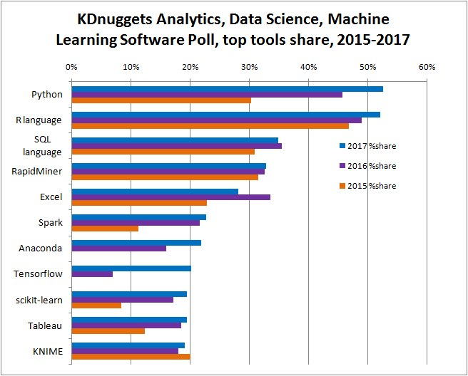
Revisit: R is popular; Don’t get left behind.
To learn Python, choose “IST 5520 – Data Science and Machine Learning with Python” offered in Spring.
http://www.kdnuggets.com/2017/05/poll-analytics-data-science-machine-learning-software-leaders.html

Slide 7
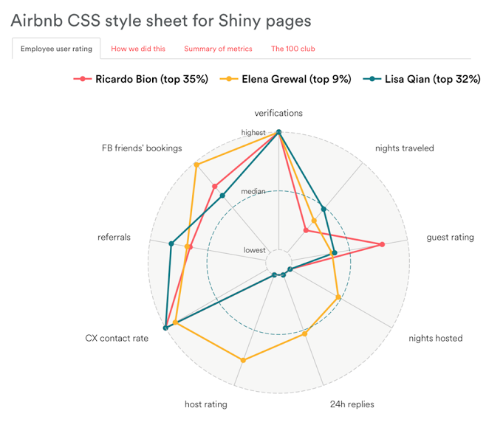
How Big Companies Are Using R for Data Analysis
Airbnb: 80% of Airbnb data scientists use R, and 64% of them use it as their primary analysis tool;
Internal R package called Rbnb;
Predict re-booking rates using past guest ratings; automate guest/host matching;
Internal reporting and data visualizations

Slide 8
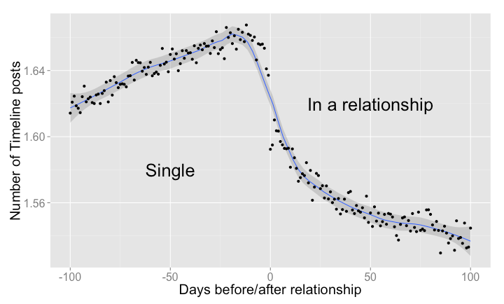
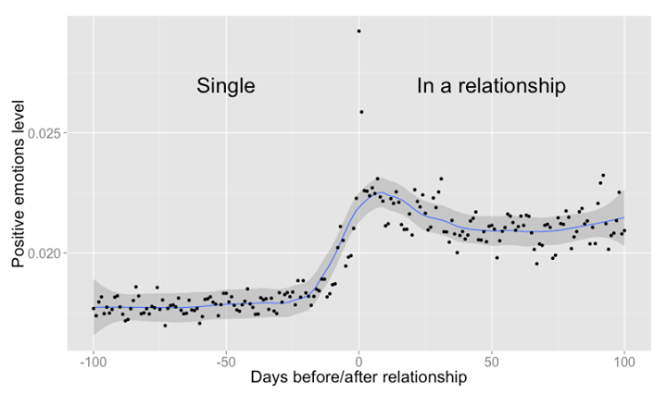
How Big Companies Are Using R for Data Analysis
Facebook - Behavior analysis related to status updates and profile pictures;
Google - Advertising effectiveness and economic forecasting;
Twitter - Semantic clustering;
Zillow - Estimation of a property’s value; $1.2M prize in a Kaggle competition

Slide 9
Steep Learning Curve for R
The “weird” syntax of R
“The best thing about R is that it was developed by statisticians. The worst thing about R is that ... it was developed by statisticians.”
-- Bo Cowgill, Google
“Unlike other high-level scripting languages, such as Python or Ruby, R has a unique and somewhat prickly syntax and tends to have a steeper learning curve than other languages.”
-- Drew Conway & John White, “Machine Learning for Hackers” P2.

Slide 10
Resources for Learning R
Remember the Rseek (search engine for R language)!
http://rseek.org/
“An Introduction to R”
https://cran.r-project.org/doc/manuals/R-intro.pdf
R Language Definition
https://cran.r-project.org/doc/manuals/r-release/R-lang.pdf
“R Reference Card” – quick reference for important tasks
https://cran.r-project.org/doc/contrib/Short-refcard.pdf
A Step-by-Step R Tutorial
http://www.cyclismo.org/tutorial/R/
Stack Overflow Q&A Site
http://stackoverflow.com/questions/tagged/r
Commonly Used R Packages
https://support.rstudio.com/hc/en-us/articles/201057987-Quick-list-of-useful-R-packages

Slide 11
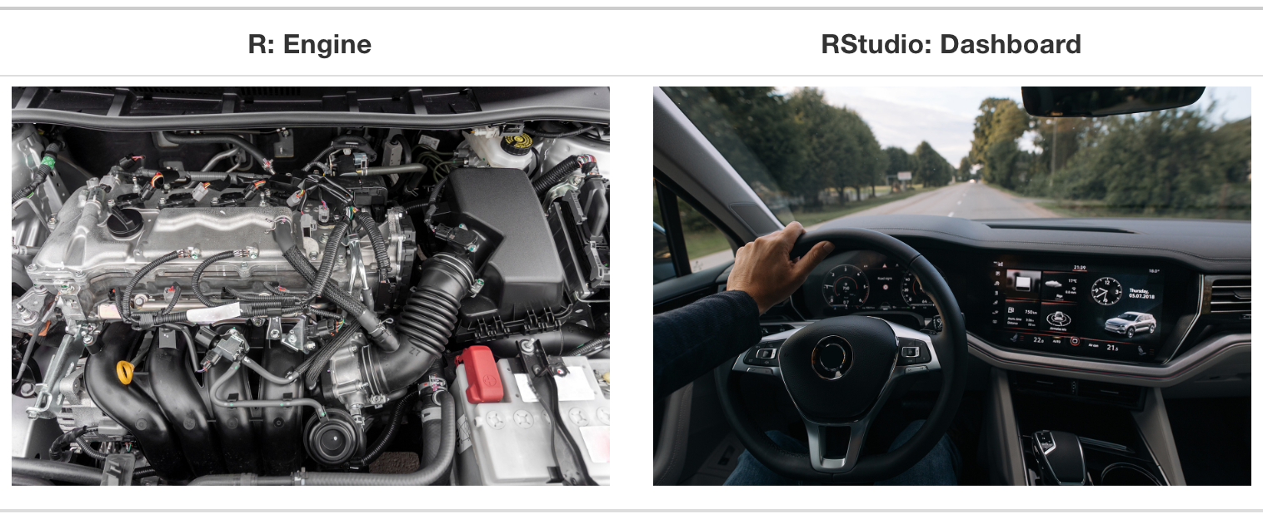
Analogy of difference between R and RStudio
R is a programming language that runs computations, while RStudio is an integrated development environment (IDE) that provides an interface by adding many convenient features and tools.

Slide 12
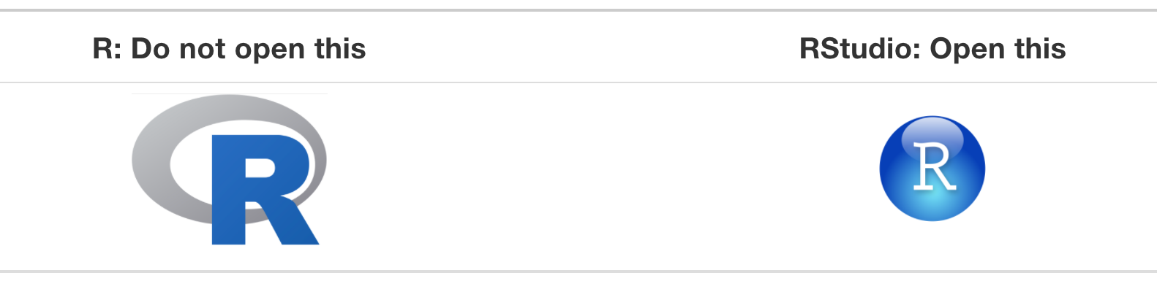
Using R via RStudio
Much as we don’t drive a car by interacting directly with the engine but rather by interacting with elements on the car’s dashboard, we won’t be using R directly but rather we will use RStudio’s interface.
After you install R and RStudio on your computer, you’ll have two new programs (also called applications) you can open. We’ll always work in RStudio and not in the R application.

Slide 13
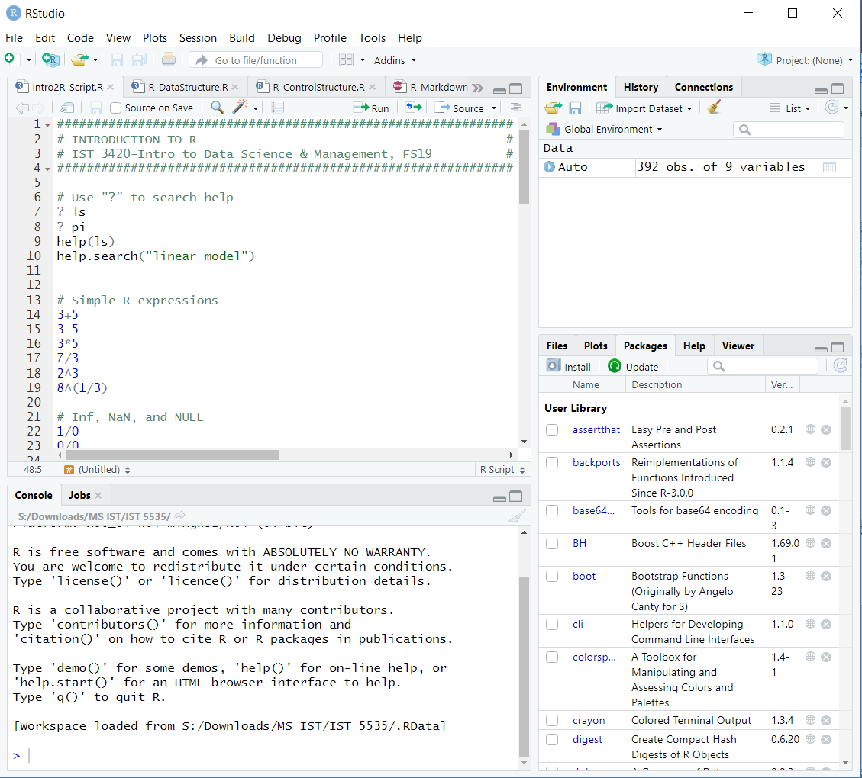
RStudio - Window Pane Layout
Source pane (top left): for editing, saving, and dispatching R code to the console;
Console pane (bottom left): any code entered here is processed by R, ideal for testing ideas;
Environment pane (top right): information about the current objects loaded in the workspace;
Files pane (bottom right): contains a file browser, a Plots tab, Help and Package tabs and a Viewer for visualizing interactive R output.
Notes:
https://bookdown.org/csgillespie/efficientR/set-up.html#window-pane-layout

Slide 14
Some Useful RStudio Keyboard Shortcuts
For a complete list, refer to https://support.rstudio.com/hc/en-us/articles/200711853-Keyboard-Shortcuts
Function | Windows & Linux | Mac
Move cursor to Source Editor | Ctrl + 1 | Ctrl + 1
Move cursor to Console | Ctrl + 2 | Ctrl + 2
Interrupt currently executing command | Esc | Esc
Navigate command history | Up/Down | Up/Down
Run current line/selection | Ctrl + Enter | Command + Enter
Save active document | Ctrl + S | Command + S

Slide 15
R Basic Concepts
Everything that exists in R is an object.
Everything that happens in R is a function call.
Interfaces to other software are part of R.
Source: Chambers, John M. Extending R. CRC Press, 2016.

Slide 16
Attributes of an Object
names
dimnames
dim
class
attributes (contain metadata)
length (works on vectors and lists)
nchar (number of characters in a string)
Examples:
x <- 10
class(x) # "numeric“
x <- 1:12; dim(x) <- c(3,4)
x
[,1] [,2] [,3] [,4]
[1,] 1 4 7 10
[2,] 2 5 8 11
[3,] 3 6 9 12

Slide 17
Basic Operations
R is case sensitive!
Use “?” to search help
Constants and symbols
Any number typed directly is a constant.
The name of a variable is a symbol.
Two assignment operators
Left assignment <- (for example, a <- 4)
Right assignment -> (for example, 4 -> b)
List indexing: $

Slide 18
Atomic Data Types
Character
“a”, “hello”
Logical
TRUE, FALSE
Integer
x <- 5L # Must add L at the end to explicitly denote integer
Double
4, 13.48
Complex
2 + 3i

Slide 19
R Basic Operators
Arithmetic Operators
Operator | Meaning | Unary or Binary
+ | Plus | Both
- | Minus | Both
* | Multiplication | Binary
/ | Division | Binary
^ | Exponentiation | Binary
%% | Modulus | Binary
%/% | Integer division | Binary
%*% | Matrix product | Binary
%o% | Outer product | Binary

Slide 20
(cont.)
Comparison Operators
Operator | Meaning | Unary or Binary | Example (a is 4) | Result
< | Less than | Binary | a < 0 | FALSE
> | Greater than | Binary | a > 0 | TRUE
== | Equal to | Binary | a == 3 | FALSE
>= | Greater than or equal to | Binary | a >= 0 | TRUE
<= | Less than or equal to | Binary | a <= 0 | FALSE
!= | Not equal to | Binary | a !=3 | TRUE

Slide 21
(cont.)
Logic Operators
Operator | Meaning | Unary or Binary | Example (a is TRUE, b is FALSE) | Result
& | And, vectorized | Binary | a & b | FALSE
| | Or, vectorized | Binary | a | b | TRUE
&& | And, not vectorized | Binary | a && b | FALSE
|| | Or, not vectorized | Binary | a || b | TRUE
! | Not | Unary | !a | TRUE
xor | Exclusive or | Binary | xor(a,b) | TRUE
isTrue() | Test if true | Unary | isTRUE(b) | FALSE

Slide 22
True Tables for Logical Operators
a | b | !a | a & b | a | b | a && b | a || b | xor(a,b)
TRUE | TRUE | FALSE | TRUE | TRUE | TRUE | TRUE | FALSE
TRUE | FALSE | FALSE | FALSE | TRUE | FALSE | TRUE | TRUE
FALSE | TRUE | TRUE | FALSE | TRUE | FALSE | TRUE | TRUE
FALSE | FALSE | TRUE | FALSE | FALSE | FALSE | FALSE | FALSE

Slide 23
Inf, NaN, and NULL
Inf and -Inf are positive and negative infinity
NaN (not a number, an undefined value)
NULL means that object does not exist
> 1/0
[1] Inf
> 0/0
[1] NaN
> 1/0 + 1/0
[1] Inf
> 1/0 - 1/0
[1] NaN
> sin(Inf)
[1] NaN
Warning message: In sin(Inf) : NaNs produced
> dim(1)
NULL

Slide 24
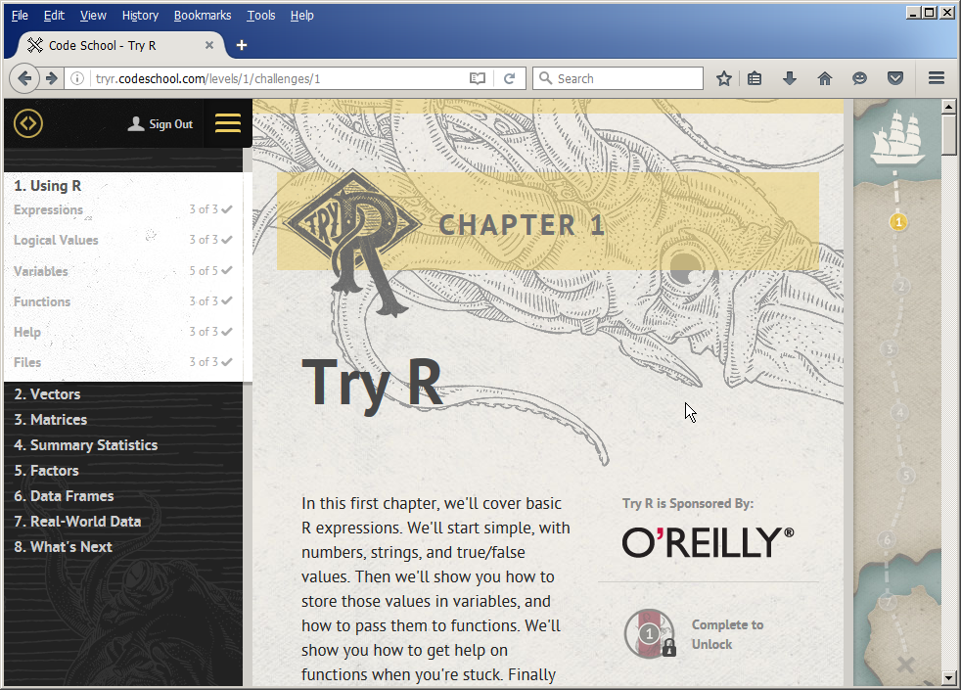
To be familiar with R
http://tryr.codeschool.com/levels/1/challenges/1

Slide 25
Data Structures in R

Slide 26
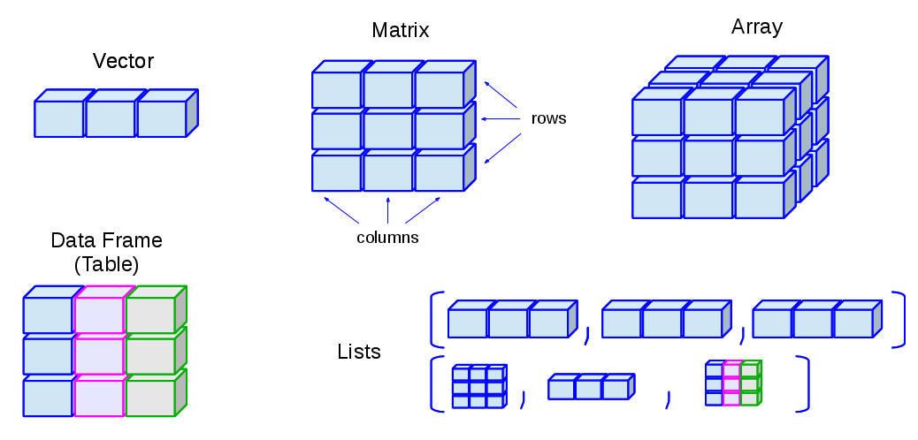
R Data Structures
Vectors, matrices, arrays, data frames (like tables in a RDBMS), and lists
Image source: http://venus.ifca.unican.es/Rintro/dataStruct.html
Notes:
Generally speaking, data science is about manipulating and analyzing data. To archive this goal, we need effective data structures which make the manipulation and analysis much easier.
One advantage of R is that it provides a wide range of data structures to let us to effectively manipulate and analyze data.
Vectors: one-dimensional arrays used to store collection data of the same mode
Numeric Vectors (mode: numeric)
Complex Vectors (mode: complex)
Logical Vectors (model: logical)
Character Vector or text strings (mode: character)
Matrices: two-dimensional arrays to store collections of data of the same mode. They are accessed by two integer indices.
Arrays: similar to matrices but they can be multi-dimensional (more than two dimensions)
Factors: vectors of categorical variables designed to group the components of another vector with the same size
Lists: ordered collection of objects, where the elements can be of different types
Data Frames: generalization of matrices where different columns can store different mode data.
Functions: objects created by the user and reused to make specific operations.

Slide 27
Vectors
One-dimensional arrays used to store collection data of the same mode (e.g. numeric, logical, character, complex)
Create a vector of numbers
v1 <- c(1,2,3,4)
Use [ ] to access vector elements
Create a vector of strings
v2 <- c("a","b","c")
Elements in a vector should be of the same type
v3 <- c(1, "a")
mode(v3) # Check the type of storage mode [1] "character"
c function: c means “combine”

Slide 28
Plot Vectors
Plot vectors
v4 <- c(10.4, 5.6, 3.1, 6.4, 21.7)
plot(v4) # plot the vector
plot(v4, type = "l", col = "red") # plot the vector in line graph

Slide 29
Names of Vectors
Use names() to set or get names of an object
> v4
[1] 10.4 5.6 3.1 6.4 21.7
> names(v4) <- c("East","North","West","South","Central") # To set vector name
> v4
East North West South Central
10.4 5.6 3.1 6.4 21.7
> names(v4) # To get vector name
[1] "East" "North" "West" "South" "Central"

Slide 30
Bar Plot
barplot(v4)

Slide 31
Sequences
Use colon :
Use seq() function
> 5:9
[1] 5 6 7 8 9
> seq(5,9)
[1] 5 6 7 8 9
> seq(5,9,by = 1)
[1] 5 6 7 8 9
> seq(5,9,by = 0.5)
[1] 5.0 5.5 6.0 6.5 7.0 7.5 8.0 8.5 9.0
> seq(from = 5, to = 9, by = 0.4)
[1] 5.0 5.4 5.8 6.2 6.6 7.0 7.4 7.8 8.2 8.6 9.0
> seq(0, 1, length.out = 11)
[1] 0.0 0.1 0.2 0.3 0.4 0.5 0.6 0.7 0.8 0.9 1.0

Slide 32
Plot
> x <- seq(0,10, by=0.01)
> plot(x,sin(x),type ="l")

Slide 33
Repetitions
Use rep( ) function
> rep(1:4, 3)
[1] 1 2 3 4 1 2 3 4 1 2 3 4
> rep(1:4, each = 3)
[1] 1 1 1 2 2 2 3 3 3 4 4 4
> rep(1:4, c(3,3,3,3))
[1] 1 1 1 2 2 2 3 3 3 4 4 4
> rep(1:4, c(1,2,3,4))
[1] 1 2 2 3 3 3 4 4 4 4

Slide 34
Vector Math
Most arithmetic operations work as well
> a <- c(1,2,3,4)
> b <- a + 2
> a*2
[1] 2 4 6 8
> a/3
[1] 0.3333333 0.6666667 1.0000000 1.3333333
> a^2
[1] 1 4 9 16
> a<b
[1] TRUE TRUE TRUE TRUE
> sin(b)
[1] 0.1411200 -0.7568025 -0.9589243 -0.2794155

Slide 35
Logical Operators “&” vs. “&&” (“|” vs. “||”)
What’s the difference between “&” and “&&” or between “|” and “||”?
The shorter form performs elementwise comparisons (vectorized)
The longer form evaluates left to right examining only the first element of each vector (not vectorized)
(a<2)&&(b<4) is equivalent to (a[1]<2)&(b[1]<4)
> a
[1] 1 2 3 4
> b
[1] 3 4 5 6
> (a<2)&(b<4)
[1] TRUE FALSE FALSE FALSE
> (a<2)&&(b<4)
[1] TRUE

Slide 36
Matrices
A matrix is a bi-dimensional array
Rows
Columns
Similar to vector but additionally contains the dimension attribute
Using the matrix() function

Slide 37
Colum Names and Row Names
Use colnames and rownames to retrieve or set the row and column names of a matrix-like object.
> m2 <- matrix(1:12,ncol = 4, byrow = TRUE)
> m2
[,1] [,2] [,3] [,4]
[1,] 1 2 3 4
[2,] 5 6 7 8
[3,] 9 10 11 12
> colnames(m2) <- c("a","b","c","d")
> rownames(m2) <- c("i","j","k")
> m2
a b c d
i 1 2 3 4
j 5 6 7 8
k 9 10 11 12
> colnames(m2)
[1] "a" "b" "c" "d"
> rownames(m2)
[1] "i" "j" "k"

Slide 38
Matrix Computations
Addition
Subtraction
Scalar multiplication
Element-wise multiplication
Matrix multiplication
Inverse
Cholesky Decomposition

Slide 39


(cont.)
Cholesky Decomposition (Cholesky Factorization)
Every positive definite matrix A can be decomposed as
A = LL^{T}
where L is a lower triangular matrix with positive diagonal elements
A=
L=
For more information, refer to
https://en.wikipedia.org/wiki/Cholesky_decomposition

Slide 40

Plot Matrix: Maunga Whau Volcano
Maunga Whau (Mt Eden) is one of about 50 volcanos in the Auckland volcanic field. This data set gives topographic information for Maunga Whau on a 10m by 10m grid.
volcano is an elevation matrix with 87 rows and 61 columns, rows corresponding to grid lines running east to west and columns to grid lines running south to north.
Image source: http://www.teara.govt.nz/en/photograph/8706/mt-eden

Slide 41
Draw a Contour Map
v <- volcano
contour(v)

Slide 42
Draw a Perspective Plot
v <- volcano
persp(v, expand=0.2, col = "green")

Slide 43
Data Frames
Generalization of matrices where different columns can store different mode data.
Each column should be of the same type.
Similar to tables in RDBMS, or data set in SAS or SPSS, i.e. a “cases by variables” matrix of data.

Slide 44
(cont.)
Single brackets vs. double brackets
Single brackets mean subsetting, the result is a data frame
Double brackets return a vector (or use $ sign)

Slide 45
(cont.)
Rename Columns
names(data.frame)[names(data.frame)==“old.name”] <- “new.name”

Slide 46
Motor Trend Data Built in R
The mtcars is a built-in data frame which comprises fuel consumption and 10 aspects of automobile design and performance for 32 automobiles (1973–74 models).

Slide 47
Summary of All Variables(Columns)

Slide 48
Lists
A list is a special type of vector. Elements can be of different types.
Use lists act as containers.

Slide 49
(cont.)

Slide 50
Two List Index Forms
Difference between [[ and [ notations
[[ form allows only a single element to be selected using integer or character indices.
[ allows indexing by vectors.

Slide 51
R Functions

Slide 52
Functions: Closure Type Objects
So many built-in functions available
You can define your own functions
Function name
Input (argument list)
Output
> f2c <- function(f){
+ # Fahrenheit to Celsius conversion
+ c <- (f-32)*5/9
+ return(c)
+ }
> f2c(90)
[1] 32.22222
> f2c(32)
[1] 0
> typeof(f2c)
[1] "closure"

Slide 53
Writing Your Own Functions
Syntax function ( arglist ) body
The keyword function indicates that you want to create a function.
An argument list is a comma separated list of formal arguments. A formal argument can be a symbol, a statement of the form ‘symbol = expression’, or the special formal argument ‘...’.
The body can be any valid R expression. Generally, the body is a group of expressions contained in curly braces (‘{’ and ‘}’) called block.
Generally functions are assigned to symbols but they don’t need to be (anonymous functions).
Source: https://cran.r-project.org/doc/manuals/r-release/R-lang.html

Slide 54
(cont.)
Formal arguments define the variables whose values will be supplied at the time the function is invoked. The names of these arguments can be used within the function body.
Default values for arguments can be specified using the special form ‘name = expression’. In this case, if the user does not specify a value for the argument when the function is invoked, the expression will be associated with the corresponding symbol.
Source: https://cran.r-project.org/doc/manuals/r-release/R-lang.html

Slide 55
Control Structures in R

Slide 56
Statement
Computation in R consists of sequentially evaluating statements.
Statements, such as x<-1:10 or mean(y), can be separated by either a semi-colon or a new line.
Whenever the evaluator is presented with a syntactically complete statement that statement is evaluated and the value returned.
The result of evaluating a statement can be referred to as the value of the statement. The value can always be assigned to a symbol.
Both semicolons and new lines can be used to separate statements. A semicolon always indicates the end of a statement while a new line may indicate the end of a statement. If the current statement is not syntactically complete new lines are simply ignored by the evaluator. If the session is interactive the prompt changes from ‘>’ to ‘+’.
> x <- 0; x + 5
[1] 5
> y <- c(1,2,3,
+ 4,5,6)
> y
[1] 1 2 3 4 5 6
Source: https://cran.r-project.org/doc/manuals/r-release/R-lang.html

Slide 57
Block (Grouped Expression)
Statements can be grouped together in braces, {expr_1; ...; expr_m}
A group of statements is sometimes called a block.
Blocks are not evaluated until a new line is entered after the closing brace “}”.
The value of the block is the result of the last expression in the block evaluated.
b = {a <- 0
a + 5}
> b = {a <- 0
+ a + 5}
> b
[1] 5

Slide 58
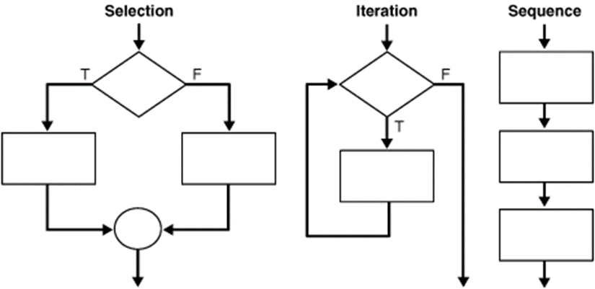
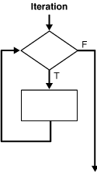
Structure Theorem
According to the structure theorem, any computable program can be written using three basic control structures:
Sequence: executing one subprogram, and then another subprogram
Selection: executing one of two subprograms according to the value of a boolean expression
Iteration (loop): executing a subprogram until a boolean expression is false
Reading: http://en.wikipedia.org/wiki/Structured_program_theorem

Slide 59
Selection Structure
One-way selection structure
Two-way selection structure

Slide 60
One-Way Selection Structure in R
Syntax if(logic expression) {...}
Function
is.even <- function(x){
if(x%%2==0){
return(TRUE)
}
}
Test
> is.even(24)
[1] TRUE
> is.even(23)
> is.even(10.5)

Slide 61
Two-Way Selection Structure in R
Syntax if(logic expression) {...} else {...}
Function
is.even2 <- function(x){
if(x%%2==0){
return(TRUE)
} else{
return(FALSE)
}
}
Test
> is.even2(24)
[1] TRUE
> is.even2(23)
[1] FALSE
> is.even2(10.5)
[1] FALSE

Slide 62
Multi-Way Selection Structure
Convert score to letter grade

Slide 63
Convert score to letter grade
Function
Test
> score2grade(99)
[1] "A“
> score2grade(90.1)
[1] "A“
> score2grade(89.9)
[1] "B“
> score2grade(70.1)
[1] "C“
> score2grade(68.6)
[1] "D“
> score2grade(57)
[1] "F"
score2grade <- function(score){
if(score >= 90) return("A")
else if (score >=80) return("B")
else if (score >= 70) return("C")
else if (score >= 60) return("D")
else return("F")
}
The Nearest Rule (if else ambiguity)
The else clause matches the nearest preceding if clause in the same block.

Slide 64
Motivations for Looping
Suppose that you are given scores for 100 students, you need to calculate letter grades for them.
Scores are stored in a vector called score_v.
Grades should be stored in a vector called grade_v.
How do you solve this problem?

Slide 65
Opening Problem
Problem: it would be tedious to write 100 statements
grade_v[1] = score2grade(score_v[1])
grade_v[2] = score2grade(score_v[2]) grade_v[3] = score2grade(score_v[3])
grade_v[4] = score2grade(score_v[4]) grade_v[5] = score2grade(score_v[5])
grade_v[6] = score2grade(score_v[6])
…
…
…
grade_v[98] = score2grade(score_v[98])
grade_v[99] = score2grade(score_v[99]) grade_v[100] = score2grade(score_v[100])
100 times

Slide 66
Introducing Loops
grade_v <- NULL
for (i in 1:100)
grade_v[i] = score2grade(score_v[i])
In general, loop constructs control repeated executions of a block of statements.

Slide 67
Loop Structure in R
R provides three statements to support looping
for statement
while statement
repeat statement
Two statements used to explicitly control looping
break statement
next statement

Slide 68
for Loop
Syntax for (name in vector) statement
# Generate random scores for 100 students
score_v <- sample(50:100, 100, replace=T)
print(score_v)
# Use for loop
grade_v <- NULL # Initiate a grade vector
for (i in 1:100)
grade_v[i] = score2grade(score_v[i])
print(grade_v) # Show the grades calculated

Slide 69
while Loop
Syntax while (logic expression) statement
# Use while loop
grade_v <- NULL
i <- 1
while (i <= 100){
grade_v[i] = score2grade(score_v[i])
i <- i + 1
}
print(grade_v) # Show the grades calculated

Slide 70
repeat Loop
Syntax repeat
statement
if (condition) break
# Use repeat loop
grade_v <- NULL
i <- 1
repeat {
grade_v[i] = score2grade(score_v[i])
i <- i + 1
if (i == 101) break
}
print(grade_v) # Show the grades calculated

Slide 71
Which Loop to Use?
The three forms of loop statements, for, while, and repeat, are expressively equivalent.
You can write a loop in any of these three forms.
No matter which loop you choose, ensure that a termination is explicitly set by testing a condition, or an infinite loop may occur.

Slide 72
Guidelines for Choosing Loop Structures
Use the one that is most intuitive and comfortable for you.
In general, a for loop may be used if the number of repetitions is known, as, for example, when you need to print a message 100 times.
A while loop may be used if the number of repetitions is not known, as in the case of reading the numbers until the input is 0.
A repeat loop can be used to replace a while loop if the loop body has to be executed before testing the continuation condition.

Slide 73
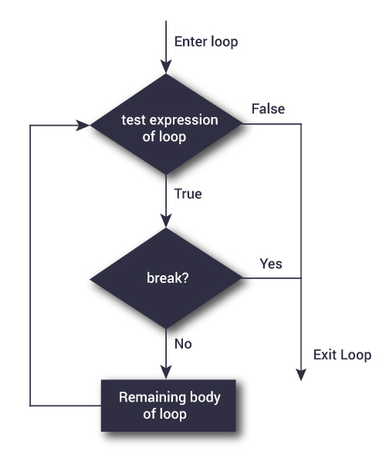
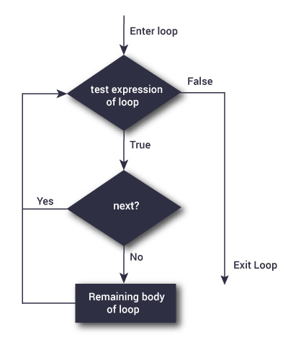
Using break and next
The break and next keywords provide additional controls in a loop.
break statement breaks out of the loop.
next statement bypasses the current iteration.
https://www.datamentor.io/r-programming/break-next/

Slide 74
break Statement
breakdemo <- function(){
sum <- 0
i <- 0
while(i < 20){
i <- i +1
if (sum >= 100)
break
sum <- sum + i
}
cat("The i is",i,"\n")
cat("The sum is",sum,"\n")
}
> breakdemo()
The i is 15
The sum is 105
break statement breaks out of the loop.
sum = 1 + 2 + 3 + ...+14 = 105

Slide 75
next Statement
nextdemo <- function(){
sum <- 0
i <- 0
while(i < 20){
i <- i +1
if (i == 10 | i ==11)
next
sum <- sum + i
}
cat("The i is",i,"\n")
cat("The sum is",sum,"\n")
}
> nextdemo()
The i is 20
The sum is 189
next statement bypasses the current iteration.
sum = 1 + 2 + ...+ 8 + 9 + 12 + 13 + ... + 20 = 189

Slide 76
while loop vs repeat loop
Syntax while (logic expression) statement
repeat statement
# Use while loop
grade_v <- NULL
i <- 1
while (i <= 100){
grade_v[i] = score2grade(score_v[i])
i <- i + 1
}
print(grade_v) # Show the grades calculated
# Use repeat loop
grade_v <- NULL
i <- 1
repeat {
grade_v[i] = score2grade(score_v[i])
i <- i + 1
if (i == 101) break
}
print(grade_v) # Show the grades calculated
“repeat loop executes at least one iteration while while loop may not execute any iterations if the condition is not fulfilled” – true or not ?

Slide 77
while loop vs repeat loop
while tests a condition to determine when to finish looping
repeat requires you to explicitly break the loop on your own and can be at any point in the body of the loop
Depending on where you place your break statement, repeat may perform further parts of an iteration compared to while
i <- 0
while (i!=2) {print(i);i<-i+1}
[1] 0
[1] 1
i
[1] 2
i <- 0
repeat {if (i==2) break;print(i);i<-i+1}
[1] 0
[1] 1
i
[1] 2
Source: https://stackoverflow.com/questions/29215589/while-vs-repeat-loops-in-r

Slide 78
Dynamic Report: R Markdown

Slide 79
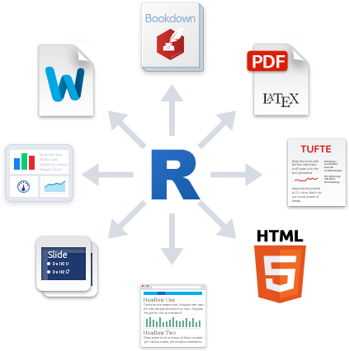
Dynamic Documents in R
“R Markdown is an authoring format that enables easy creation of dynamic documents, presentations, and reports from R”.
R code embedded in text
You can write R code in plain text and generate data analysis reports in various formats such as HTML, PDF, Word, HTML5 slides.
Reproducible analysis
You can easily reproduce the data analysis results after the data and/or code change.
Source: http://rmarkdown.rstudio.com/

Slide 80
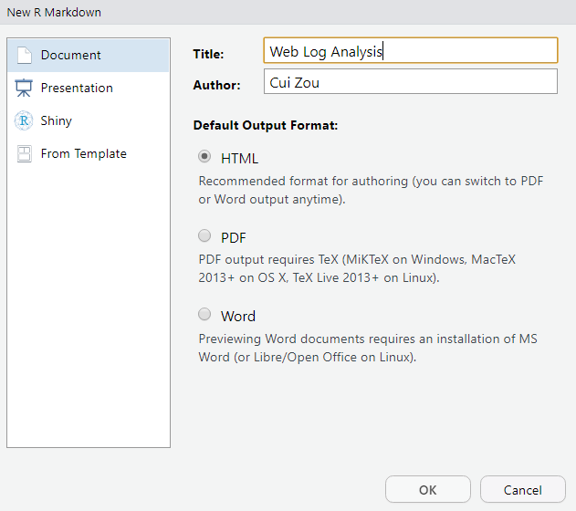
Use R Markdown
Install R markdown package
install.packages("rmarkdown")
In Rstudio, click “File -> New File -> R Markdown...” menu
In the popup window, input header information, then click “OK” button

Slide 81
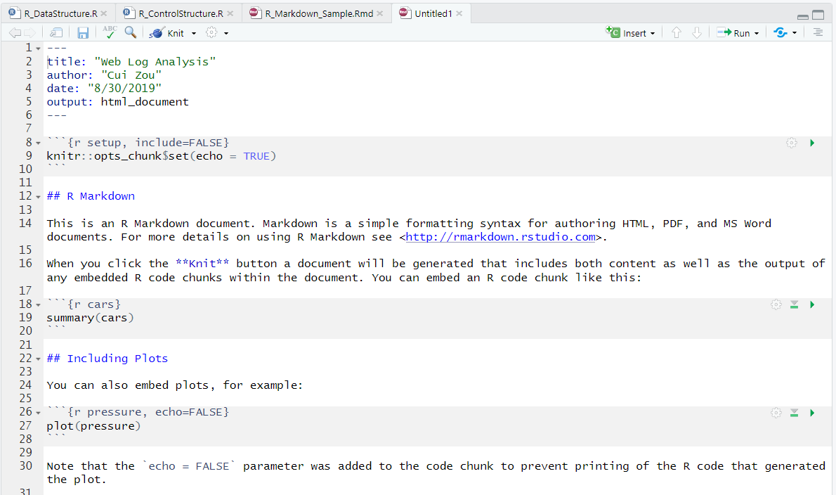
(cont.)
RStudio generates a sample R markdown (.Rmd) file for you

Slide 82
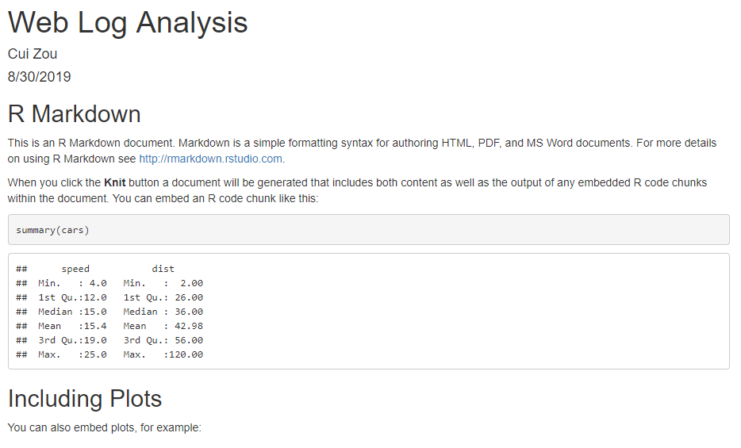
(cont.)
Click the “Knit HTML” button on the toolbar to generate the HTML report

Slide 83
(cont.)
Follow the R markdown syntax demonstrated in the sample file, write your own data analysis by editing the Rmd template.

Slide 84
R Markdown Syntax Summary
YAML Header (key: value pairs)
At the beginning of Rmd file
Between lines of ---
Plain Text Format
Headers: Begin with #
Lists: Begin with -
LaTex or MathML equations: Enclosed within $
Embedded R Code
R Code Chunks: Begin with ```{r} and end with ```
Inline R Code: Begin with `r and end with `
R Markdown Reference Guide
http://www.rstudio.com/wp-content/uploads/2015/03/rmarkdown-reference.pdf
Notes:
The symbol ` is called back-tick, back quote, grave

Slide 85
An Example
R Markdown File
PDF Output
R Markdown Sample.Rmd
R Markdown Sample.pdf

Slide 86
R Programming Style and Debug

Slide 87
Programming Style and Documentation
Programming style is important
Good programming style makes a program more readable
Good programming style helps reduce programming errors
Several guidelines
Appropriate Comments
Naming Conventions
Proper Indentation and Spacing Lines
The bottom line is: Your code needs to be easy to read and understand.

Slide 88
Google’s R Style Guide
https://google.github.io/styleguide/Rguide.xml
Summary
File Names: end in .R
Identifiers: variable.name (or variableName), FunctionName, kConstantName
Line Length: maximum 80 characters
Indentation: two spaces, no tabs
Spacing
Curly Braces: first on same line, last on own line
else: Surround else with braces
Assignment: use <-, not =
Semicolons: don't use them
General Layout and Ordering
Commenting Guidelines: all comments begin with # followed by a space; inline comments need two spaces before the #
Function Definitions and Calls
Function Documentation
Example Function
TODO Style: TODO(username)

Slide 89
Display Messages in R
stop(): provide error messages and stop execution
warning(): provide warning message and continue execution
message(): provide a general message and continue execution
sign2 <- function(x){
if(is.numeric(x)){
if (x>0){
return(1);
}
if (x==0){
warning("Input is zero!")
return(NaN)
} else {
return(-1)
}
} else{
stop("Input number be a number!")
}
}
> sign2(-23)
[1] -1
> sign2(0)
[1] NaN
Warning message: In sign2(0) : Input is zero!
> sign2(10.5)
[1] 1
> sign2("a")
Error in sign2("a") : Input number be a number!

Slide 90
Programming Errors
Syntax Errors
You type a command that R cannot understand
For example, missing commas, unmatched parentheses, wrong function name etc.
Runtime Errors
Causes the program to abort
Logic Errors
The program can run, but produce wrong results
Difficult to find
> a <- c(0,1,2,3]
Error: unexpected ']' in "a <- c(0,1,2,3]“
> a <- c(0,1,2 3)
Error: unexpected numeric constant in "a <- c(0,1,2 3"

Slide 91

Debugging
Logic errors are called bugs.
The process of finding and correcting errors is called debugging.
A common approach to debugging is to use a combination of methods to narrow down to the part of the program where the bug is located.
For a short and simple program, you can hand-trace the program (i.e., catch errors by reading the program), or you can insert print statements in order to show the values of the variables or the execution flow of the program.
For a large, complex program, the most effective approach for debugging is to use a debugger utility.

Slide 92
Debugger
Debugger is a program that facilitates debugging. You can use a debugger to
Execute a single statement at a time.
Trace into or stepping over a function.
Set breakpoints.
Display variables.
Display call stack.

Slide 93
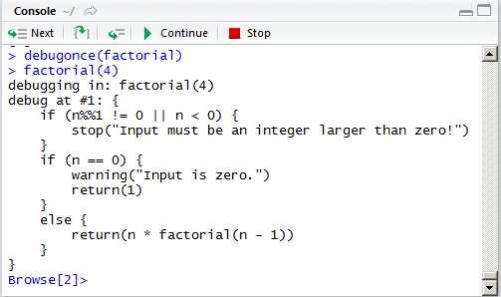
Debugging in R
Call debug() or debugonce() function to go to debug mode
Function Definition
factorial <- function(n=3){
if (n%%1!=0 || n<0){
stop("Input must be an integer larger than zero!")
}
if (n==0){
return(1)
} else{
return(n*factorial(n-1))
}
}
Debug Mode

Slide 94
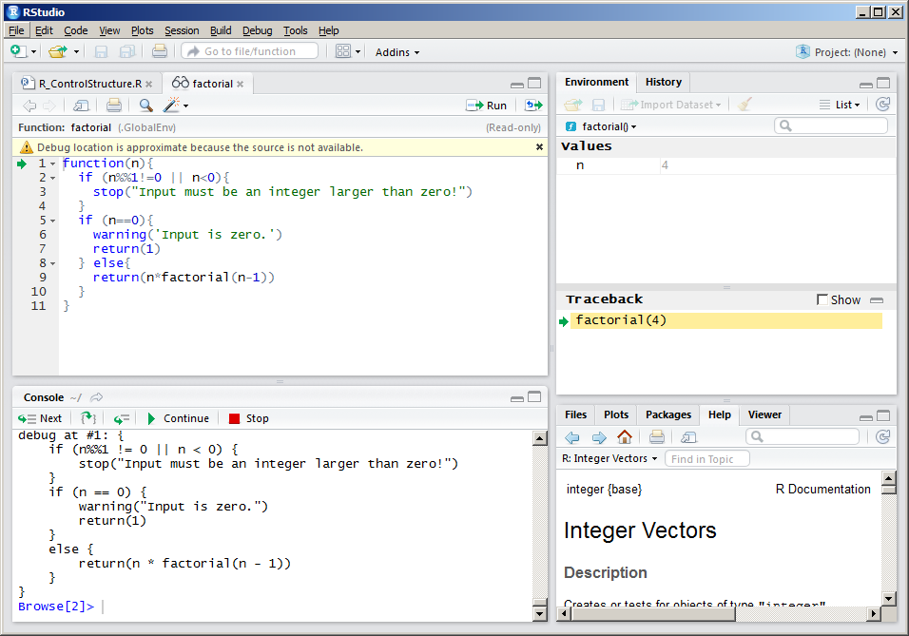
R Debugger Overview
Environment
Source Code
Traceback
Console

Slide 95
Reference
“An Introduction to R”
https://cran.r-project.org/doc/manuals/R-intro.pdf
R Language Definition
https://cran.r-project.org/doc/manuals/r-release/R-lang.pdf
Base R Cheat Sheet
http://www.rstudio.com/wp-content/uploads/2016/06/r-cheat-sheet.pdf
Advanced R Cheat Sheet
http://www.rstudio.com/wp-content/uploads/2016/02/advancedR.pdf
R Markdown Cheat Sheet
http://www.rstudio.com/wp-content/uploads/2016/03/rmarkdown-cheatsheet-2.0.pdf
R Markdown Reference Guide
http://www.rstudio.com/wp-content/uploads/2015/03/rmarkdown-reference.pdf

Slide 96
Q & A

